Slide 1


PRAGMA 20th workshop cum HKU Centennial IT Conference on Grid Applications and Research collaboration
Computer Centre,
The University of Hong Kong

Slide 2
Contents
Date, Location & website
About HKU
HKU Computer Centre & facility
Agenda
Accommodation
Tourist Attraction Highlights
Tentative timeline

Slide 3
Date, Location & Website:
Mon-Fri 2-4 March 2011
University of Hong Kong (HKU) Hong Kong SAR, China
PRAGMA 20th workshop official website: http://www.hku.hk/cc/HKU100/pragma20/
March in HK: Average temperature: 23°C (73°F), humidity around 82%
Help celebrate 100th birthday

Slide 4
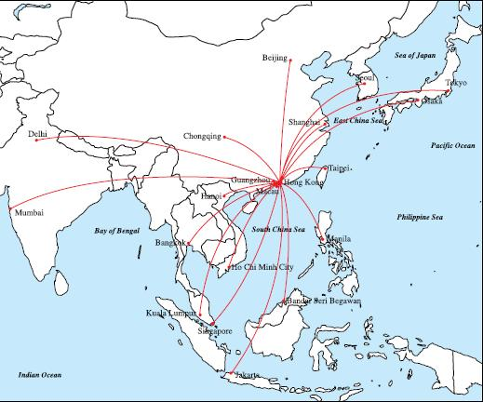
Geographical location of Hong Kong
Transport Hub : most of the major Asian cities are covered within 5-hour flight journeys

Slide 5
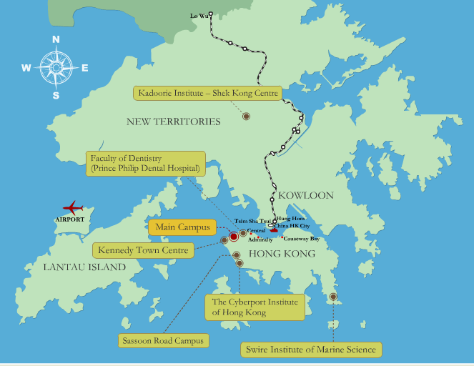
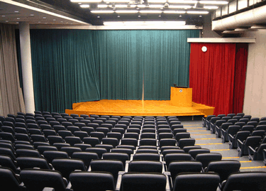
Planned Venue
On the Main Campus of HKU
Wang Gungwu Theatre of Graduate House

Slide 6
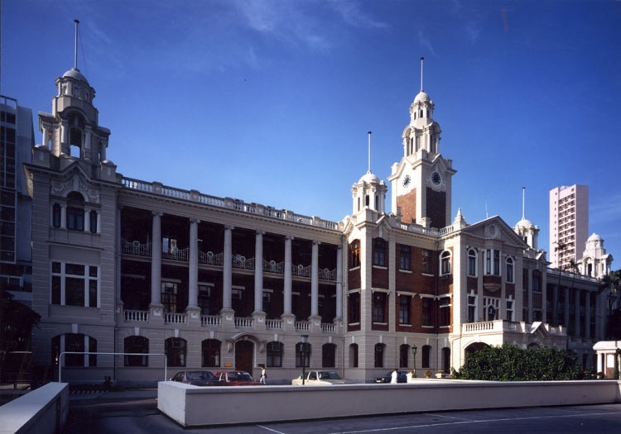
The University of Hong Kong

Slide 7

The University of Hong Kong
Founded in 1911
Ranked 23rd in "QS World University Rankings 2010”
Ranked 1st in “QS.com Asian University Rankings” 2009 & 2010
15,197 undergraduate students
12,493 postgraduate students
10 faculties
Architecture, Arts, Business and Economics,
Dentistry, Education, Engineering,
Law, Medicine, Science, Social Sciences

Slide 8

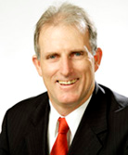
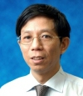
Local Organizer & Chairs
Computer Centre, The University of Hong Kong (HKU)
http://www.hku.hk/cc/
Mr. Geoffrey R. DENGATE Director, IT Services Event General Chair | Dr. P. T. HO Deputy Director, IT Services PRAGMA 20 Chair

Slide 9

HKU Computer Centre HPC/Grid Facility Advancement
HKU Grid Point system,
Rpeak 27.05TFlops

Slide 10
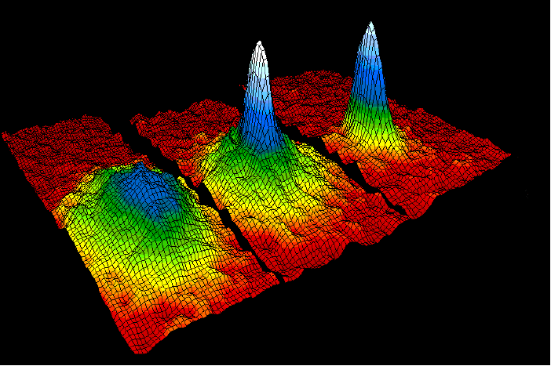
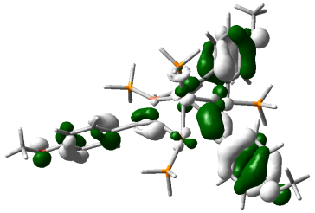
Research-related Departments
Computer System & Resources: Computer Centre, Department of Computer Science
Geosciences: Dept of Civil Engineering, Mechanical Engineering, Earth sciences, etc
Biosciences: Dept of Biochemistry, Microbiology, Pathology, Community Medicine, Genome Research Centre, etc

Slide 11
Agenda:
 | March 2 (Wed) |  | March 3 (Thu) |  | March 4 (Fri)
08:45-09:00 | Registration
09:00-10:30 | Opening Geosciences workshop (tutorial 1) | Introduction/Opening |  | Plenary session (Presentations / Demonstrations of emerging topics / Cool-things)
10:30-11:00 | Break
11:00-12:15 | Geosciences workshop (tutorial 2) | PRAGMA Panel Presentations / Presentations /Demonstrations |  | Breakout discussion session (Resources and Data, Telesciences, Biosciences, Geosciences)
12:15-13:30 | Lunch
13:30-15:00 | Geosciences workshop (tutorial 3) | Breakout discussion session (Resources and Data, Telesciences, Biosciences, Geosciences)
15:00-15:30 | Break
15:30-17:30 | Geosciences workshop (tutorial 4) | Report session & Plenary session (Presentations / Demonstrations of emerging topics / Cool-things) |  | Report session & Wrap-up
17:30-18:00 | Closing of Geosciences workshop | Wrap-up and other presentations |  | Closing
18:00-19:00 | Break
19:00-21:00 | Reception | Dinner |  | Dinner

Slide 12
Accommodation:
Many hotel choices at HK island which are near to HKU main campus. The exact hotel list is to be confirmed.
1 x Five stars hotel
1 x Four stars hotel
1 x Three stars hotel

Slide 13
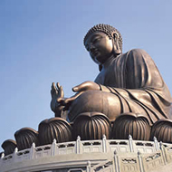
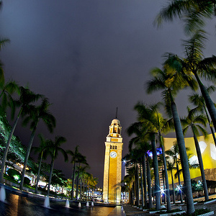
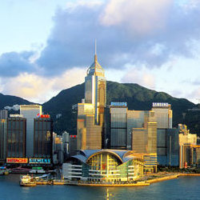
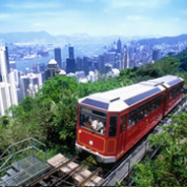
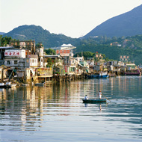
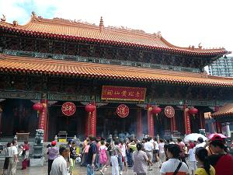
Tourist Attraction Highlights

Slide 14
Tentative timeline
15th Nov 2010 – 11th Feb 2011: Call for presentations, demonstrations & posters
15th Nov 2010 – 18th Feb 2011: Online registration and hotel booking are available
11th Feb 2011: Deadline for submission of presentations, demonstrations & posters
14st Feb 2011: Agenda & speakers are finalized
14th Feb 2011: Confirmation for all presentations, demonstrations & posters
18th Feb 2011: Deadline for registration/hotel booking

Slide 15

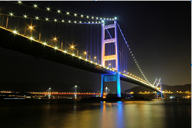
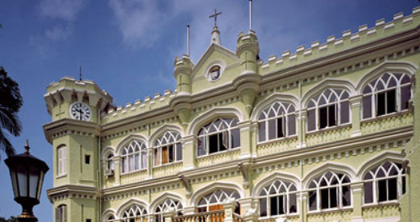
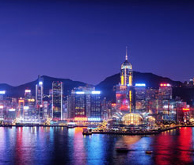
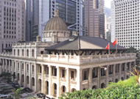
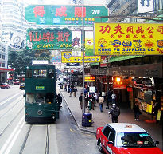
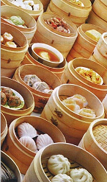
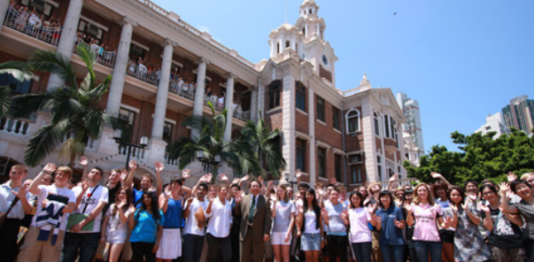
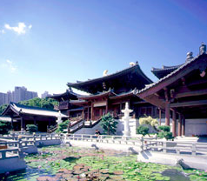
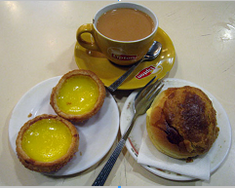
We look forward to seeing you in Hong Kong!

